Slide 1
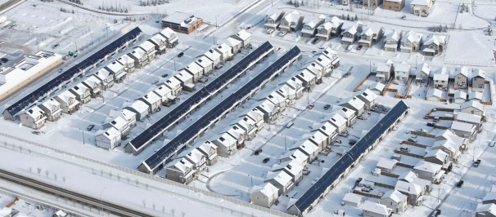
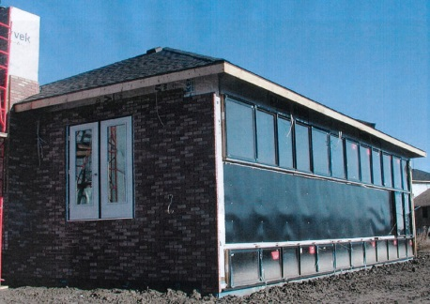
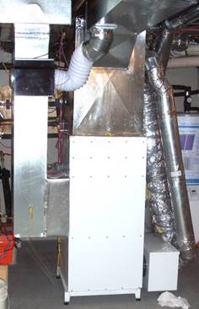
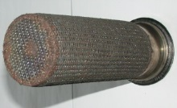
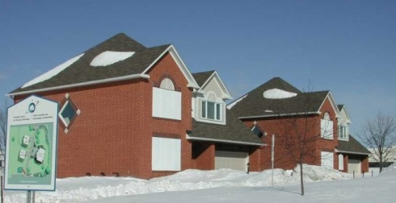
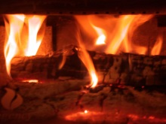
Alternative Energy Systems for Homes & Building Clusters, Moving to Net Zero
Skip Hayden
Renewables & Integrated Energy Systems
BBD 2014
Burlington, Feb 2014

Slide 2
Learning Objectives (1)
Understand the distinction and opportunities with combined, integrated and hybrid energy systems
Appreciate range of advanced hybrid energy systems that can effectively & efficiently provide heat, ventilation, and even electricity, while integrating renewables and low-to-zero C-emitting fuels
Understand the drawbacks of certain energy sources, technologies and directions

Slide 3
Learning Objectives (2)
Appreciate how energy storage and renewably-derived fuels can allow effective utilization of intermittent or seasonally-variable renewable energy (solar, wind), when coupled with hybrid technologies
Be better able to specify energy systems to move new and existing homes and building clusters toward net-zero

Slide 4
What are you looking for
?
?
?
? ?

Slide 5
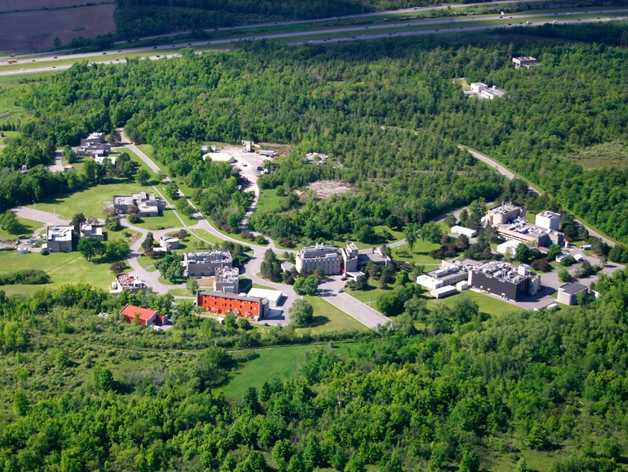
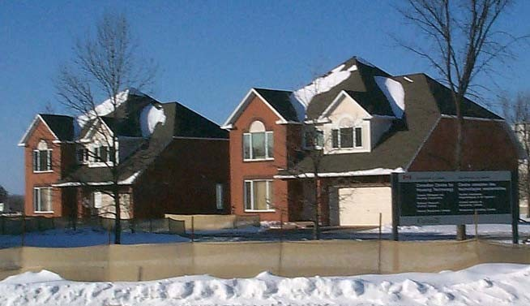
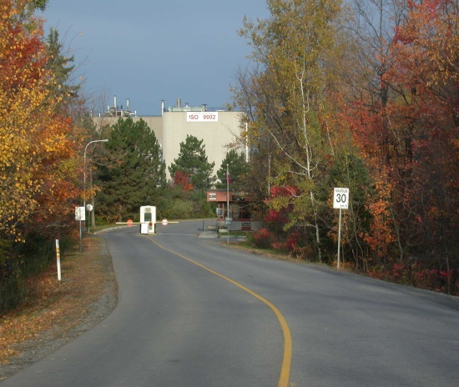

Slide 6
What do I mean by “Net Zero”

Slide 7
Net Zero
Overall production of Greenhouse Gases (GHGs) and/or utilization of fossil fuels and/or energy is minimized and approaches zero
It may be a single house/building, or a group of houses/buildings/community, or how the buildings + occupants actually can work to balance GHGs within the larger energy system

Slide 8
Definitions of Systems

Slide 9
Conventional Energy System
One Energy Source ( oil, gas, wood,…)
One Energy Use (space heating, wtr htg,…)

Slide 10
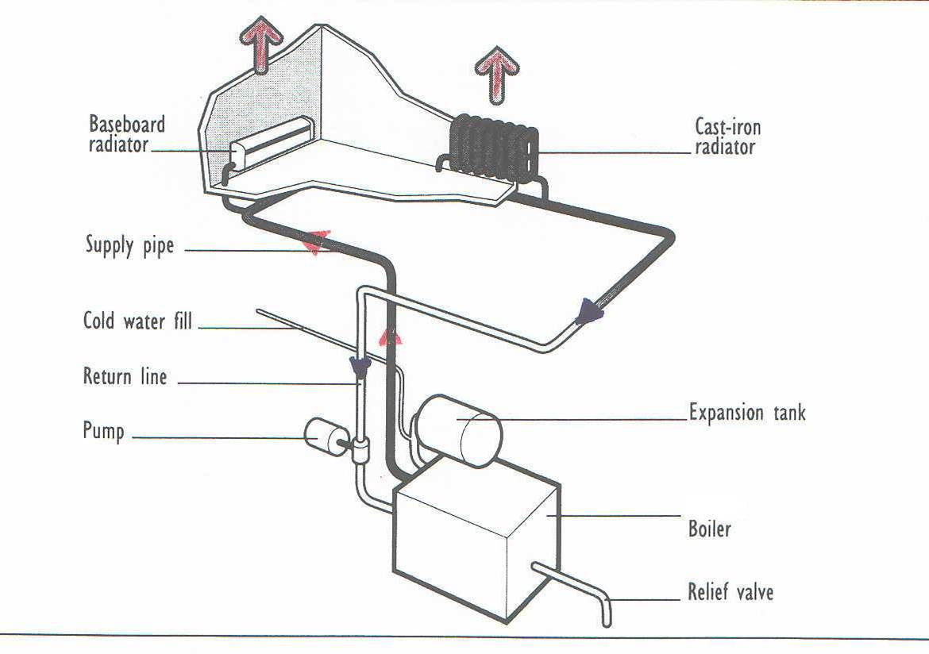
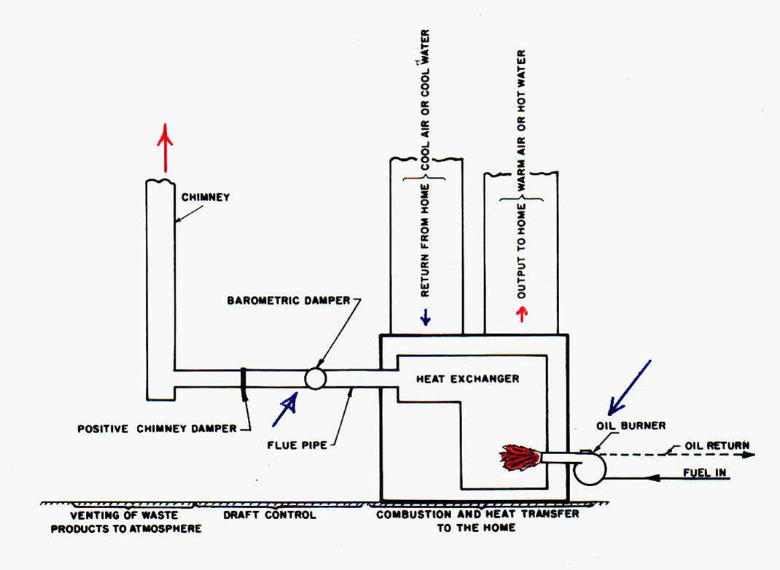
Central Heating Systems
Hydronic
Warm Air

Slide 11
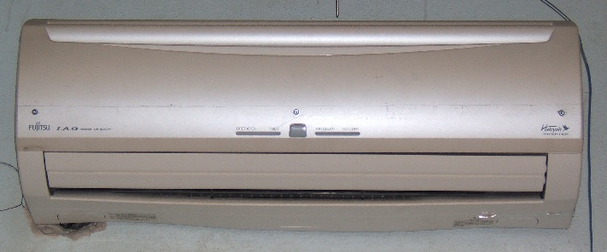
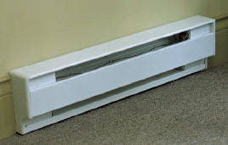
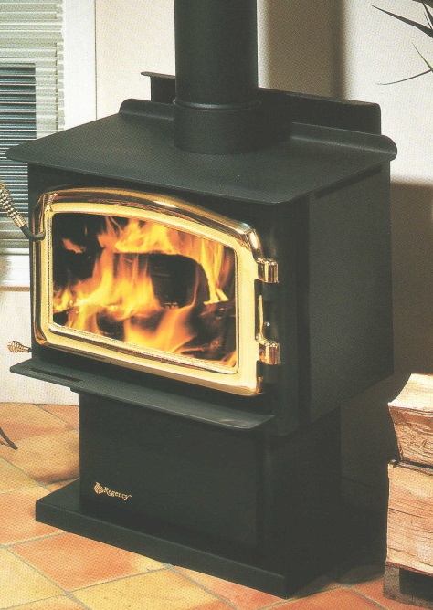
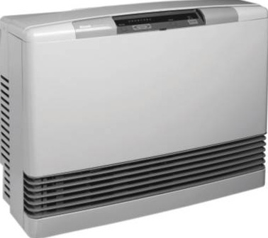
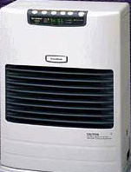
Space Heaters

Slide 12
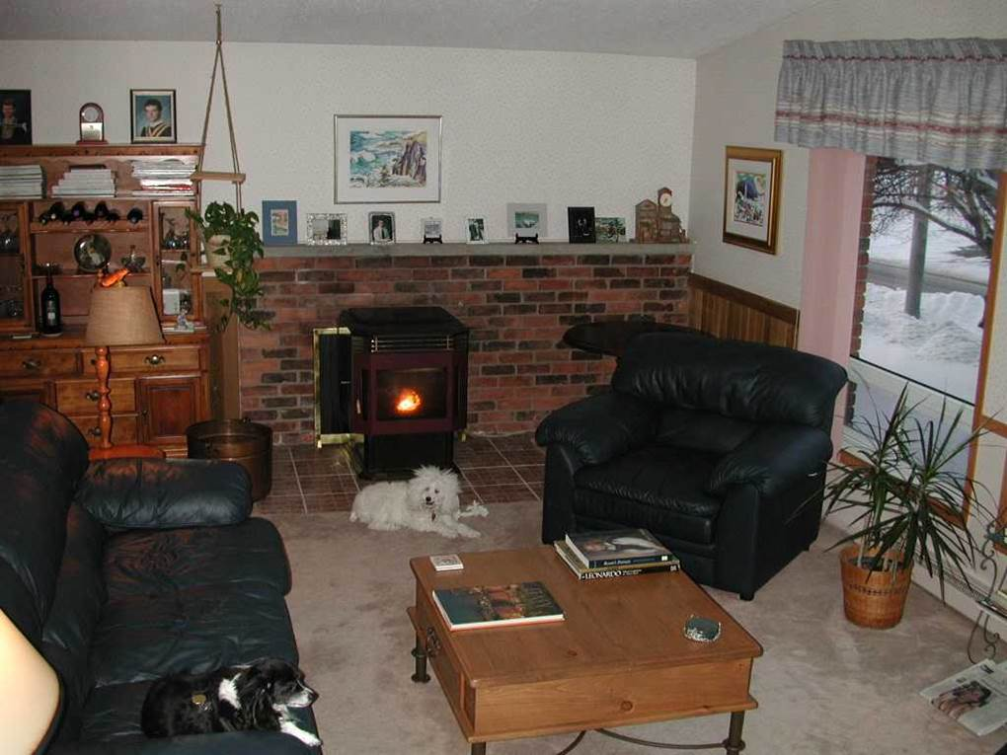
Hybrid System
Two or more energy sources

Slide 13
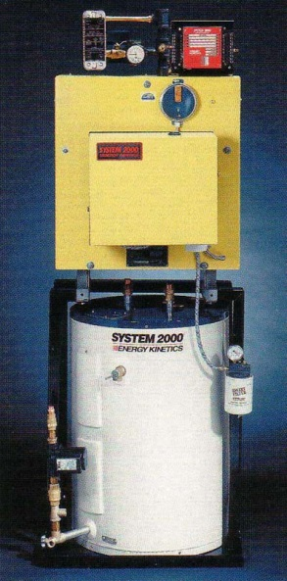
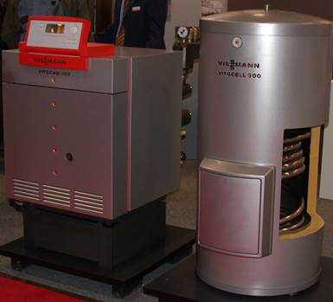
Combined System
Supplies 2 energy use functions, usually space heating and tap water heating (DHW)

Slide 14
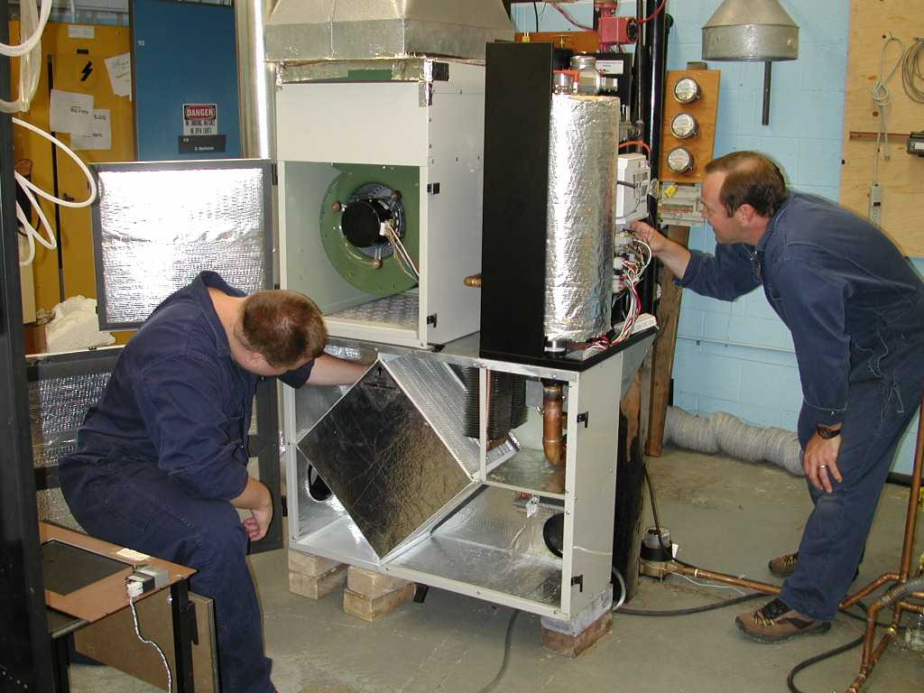
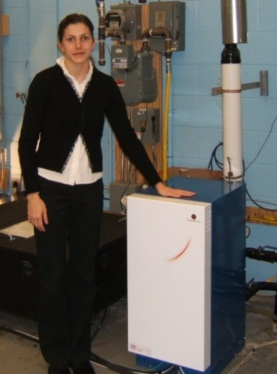
Integrated System
Carries out 3 or more energy use functions, such as space heating, domestic hot water, heat recovery ventilation, electricity generation, space cooling, …

Slide 15
Can we use oil as we move towards net zero ?

Slide 16
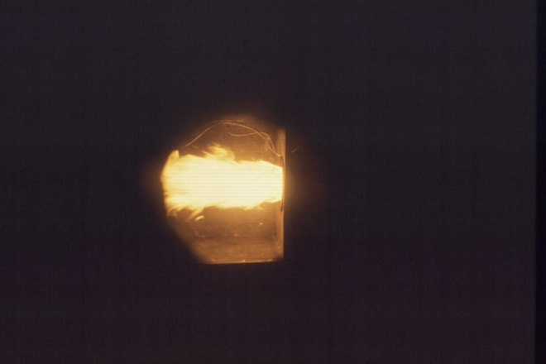
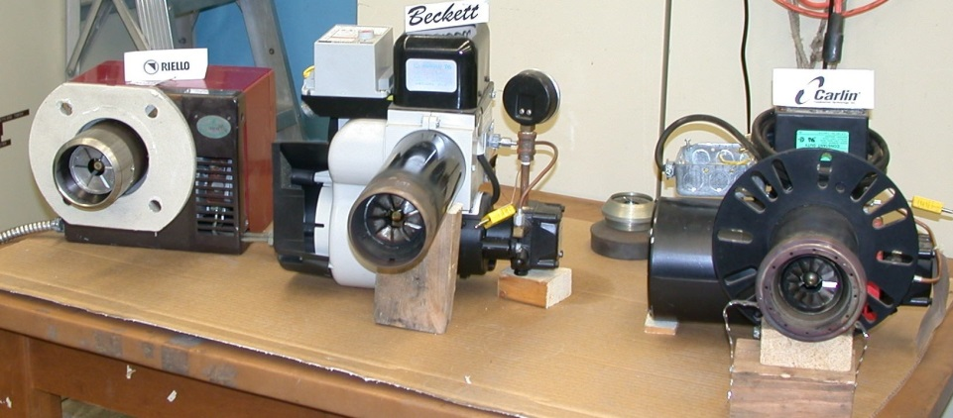
Oil
With oil burners having a lower limit between 50k Btu and 70k Btu, the firing rate is way too high for energy demands, unless something can be done with the heat

Slide 17
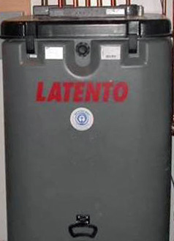
Oil towards Net Zero
A potential application would be a sophisticated combination system with a large amount of efficient energy storage, or
the coupling of multiple dwellings to one combination source

Slide 18
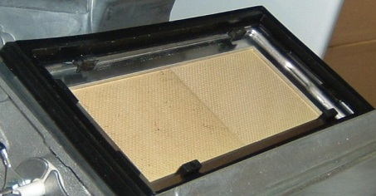
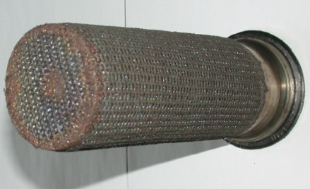
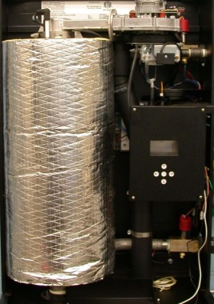
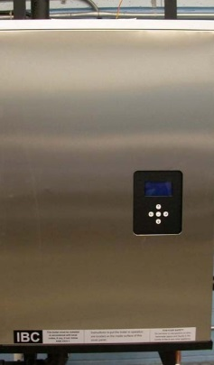
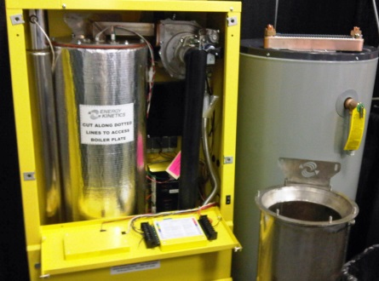
Gas and Net Zero
With new gas burner technology allowing high turndown to very low firing rate, coupled with condensing system, gas combination condensing systems may be an effective means to move towards very low energy applications
These now pave the way for integrated and hybrid technologies, such as . . . .

Slide 19
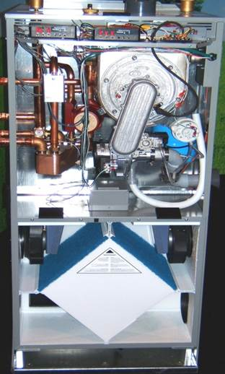
Gas Integrated System (eKoComfort)
Space Heating, Water Heating, Heat Recovery Ventilation
Condensing over 90% in all applications
Hi-modulating Burner 10:1
Efficient electrics (ECMs)
Air flow, heat, water
Can provide both forced air and radiant heating
Enables optimization of total system + other hybrid energy sources

Slide 20
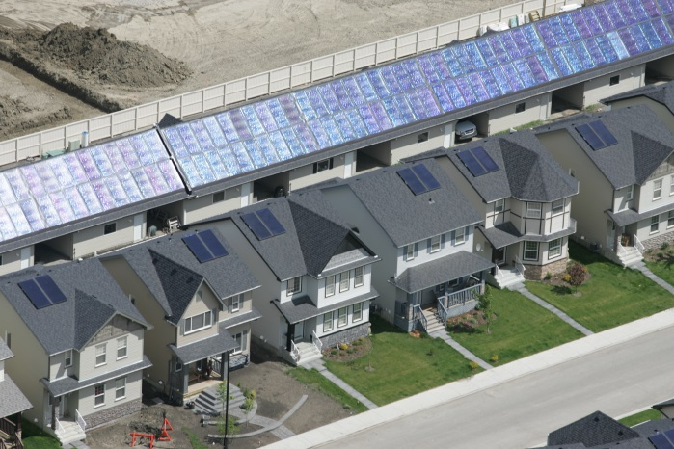
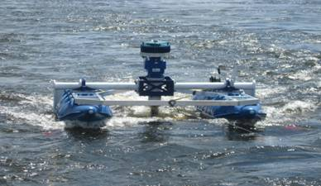
Renewable Energy

Slide 22
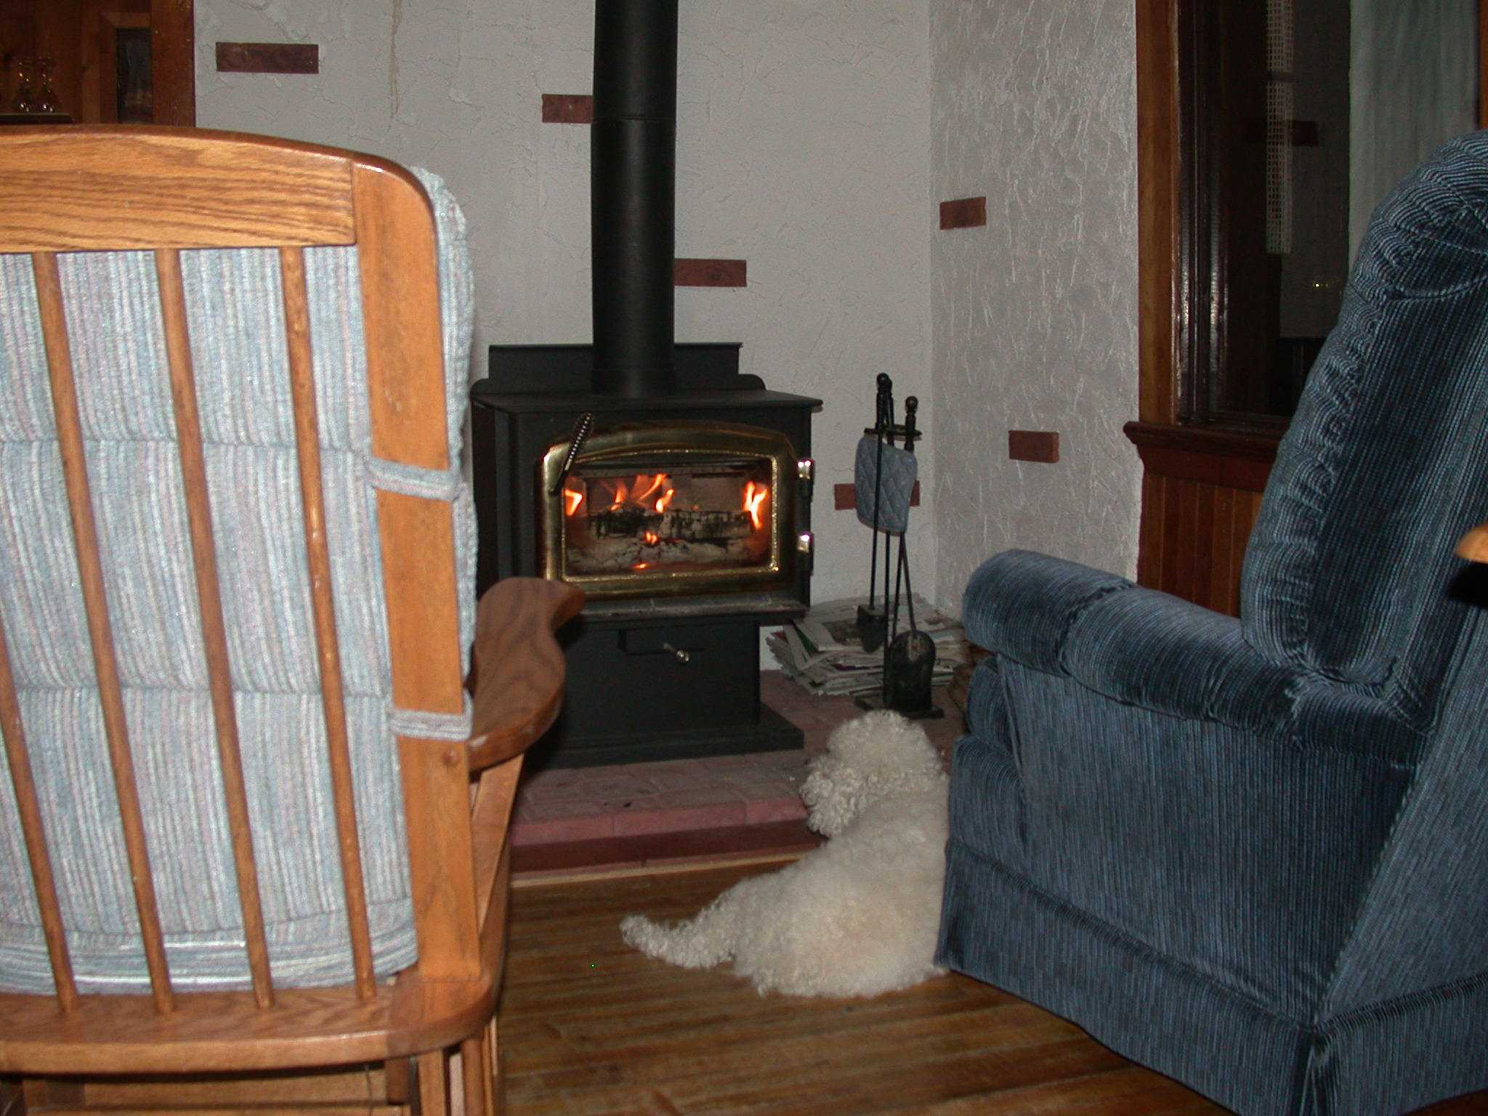
Space Heater Woodstove

Slide 24
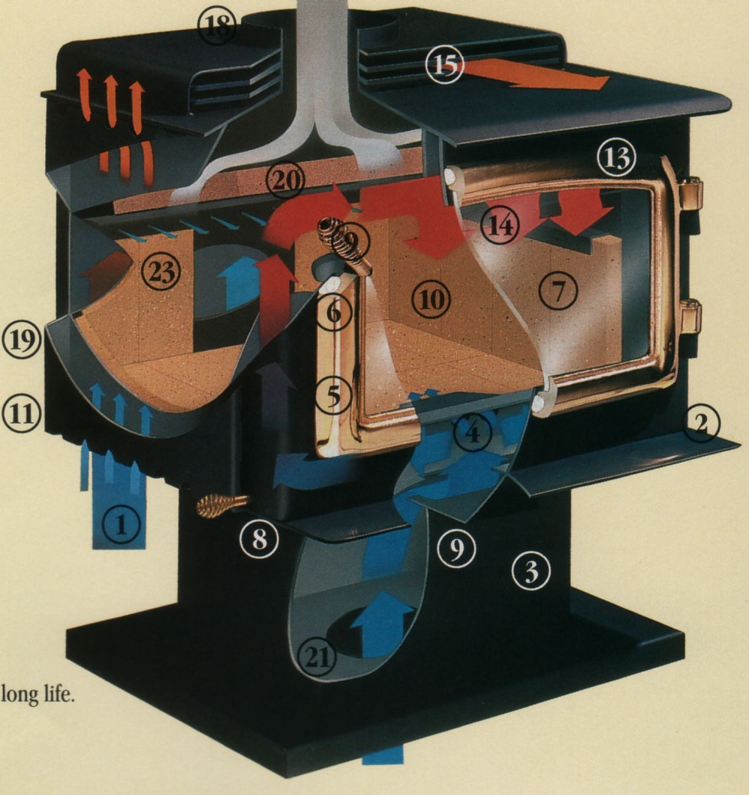
Characteristics of Advanced Combustion Woodstove Moving towards Net Zero
Effective infrared heating source
Ceramic glass door transparent to R radiation
EPA 1990 < 4.0 g/h
Preheated prim & sec air
Insulated comb. chamber & baffle
Air wash for door
Air shield on side and back
Extremely attractive, chaotic fire for “pleasure”
SMALL !
No catalyst

Slide 25
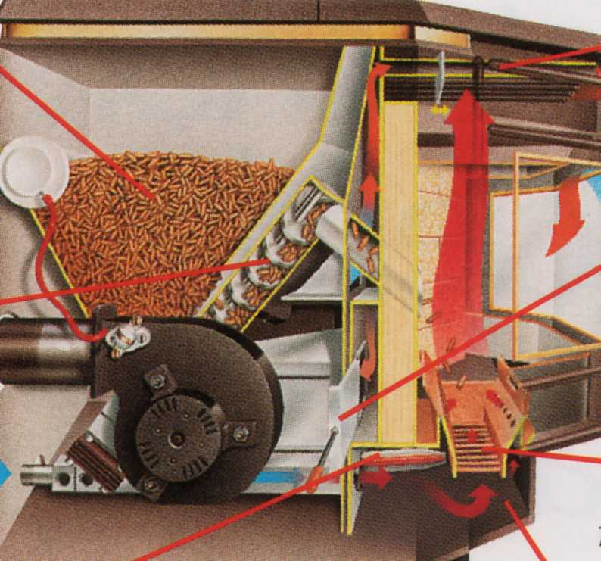
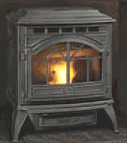
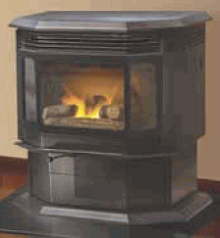
Pellet Stoves

Slide 26
Characteristics of Good Pellet Stove
Tested to EPA to ensure
low emissions
high efficiency due to low excess air (up to 80%)
Wide firing range (often 5:1), most with low output & good air control over range
Air wash for fire viewing
Small diameter flue (3-4”)
Some can burn other biomass (corn, …) (Hi ash)

Slide 27
Running a Natural Draft Wood-fired Appliance in a Tight Near Net Zero House
Choose a low output appliance ( Small ! )
Have an inside chimney with proper sizing
Use unvented double-walled pipe from appliance to chimney
Have direct source of outside air to appliance, from windward side of house
On refueling, open air control wide, crack open window on windward side of house, before loading

Slide 28
Locate these radiant space heaters in a major living area, where they can “see” a significant portion of the rest of the house

Slide 30
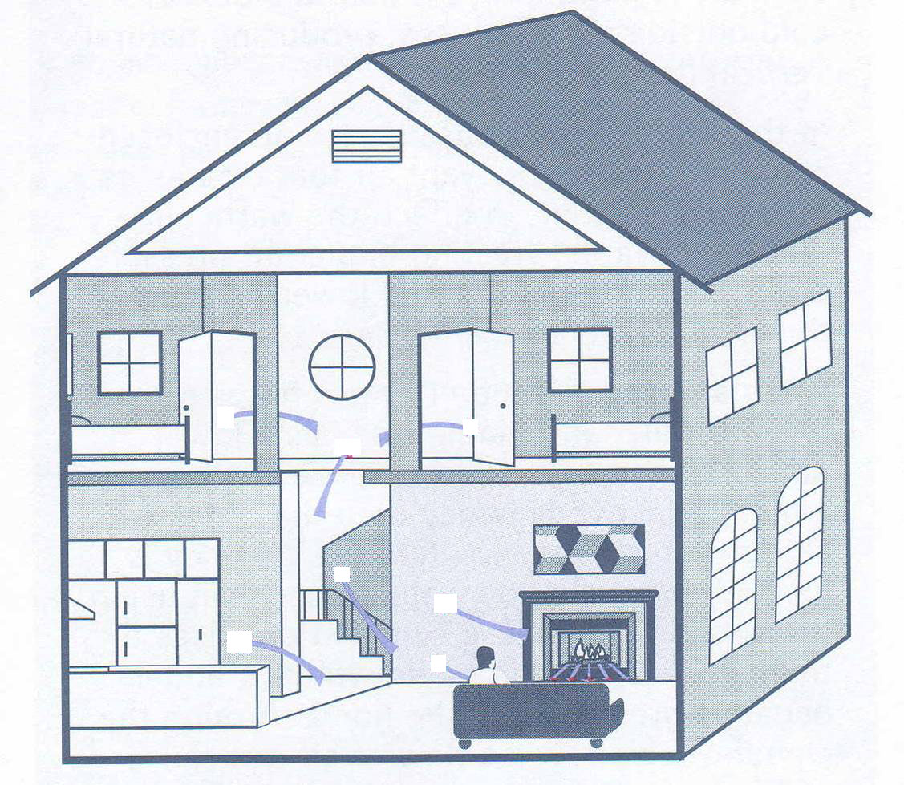
Heating

Slide 31
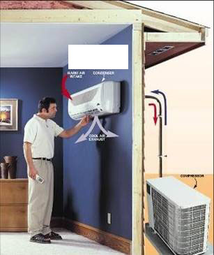
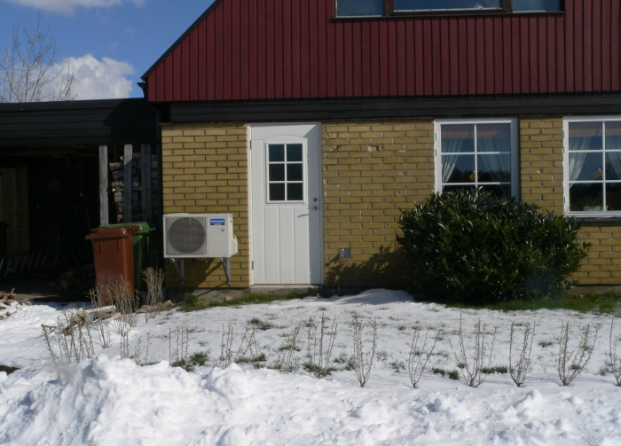
Mini-Split Heat Pumps

Slide 32
Space Heating (& Cooling) in a Near-Net –Zero House with a super-efficient Mini-Split Heat Pump

Slide 33
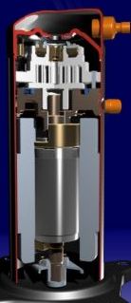
Mini-Split Advanced Technology
Inverter technology to control/vary compressor speed to load
Scroll compressor
Good turndown (5:1), maintaining high effic
Efficient DC motors
Highly-variable fan speeds and directions
Very high SEER >20; good COP at cold temp.

Slide 34
Using an advanced combustion woodstove and a mini-split heat pump to move your dwelling towards net zero

Slide 35
Heating and Air Flow

Slide 36
The Mini-Split can also help move the heat from the wood stove around the house, in an “unobtrusive” fashion, using its efficient fan system

Slide 37
Heating and Air Flow

Slide 38
The mini-split can also provide air movement and cooling in the summer

Slide 39
Cooling and Air Flow

Slide 40
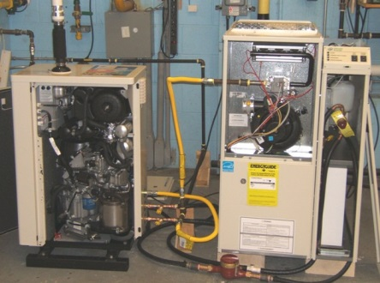
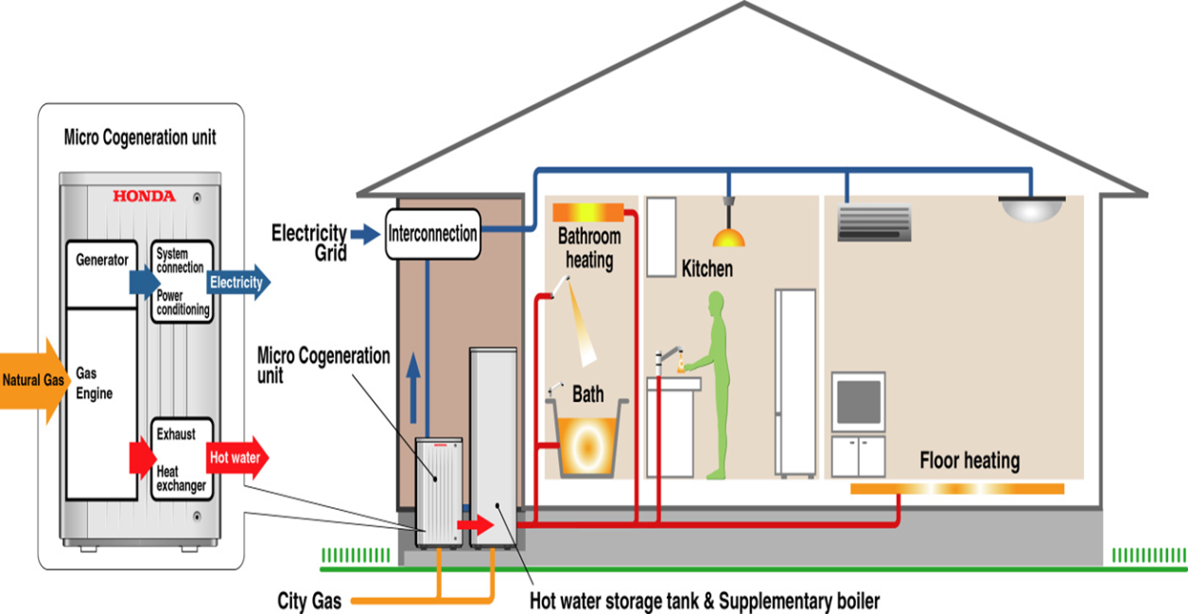
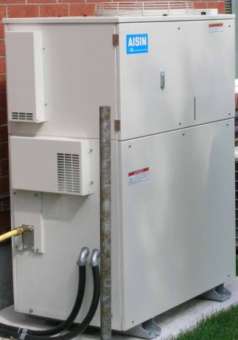
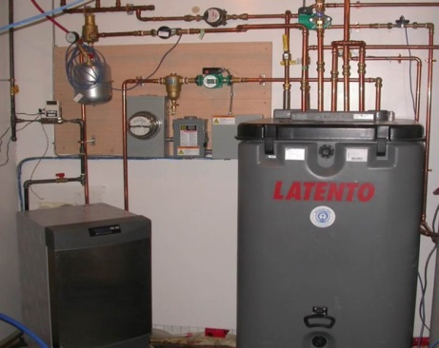
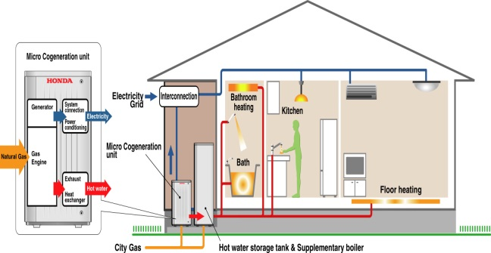
Integrated System Micro-cogeneration Space Heating, DHW, Electricity

Slide 41
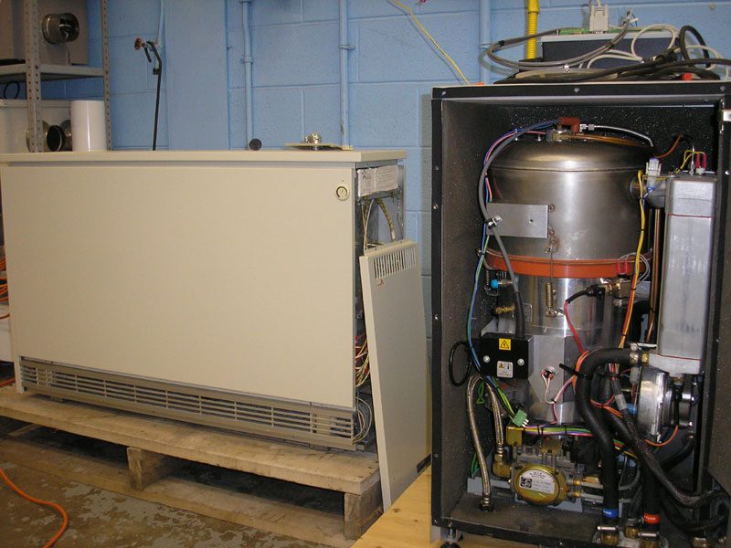
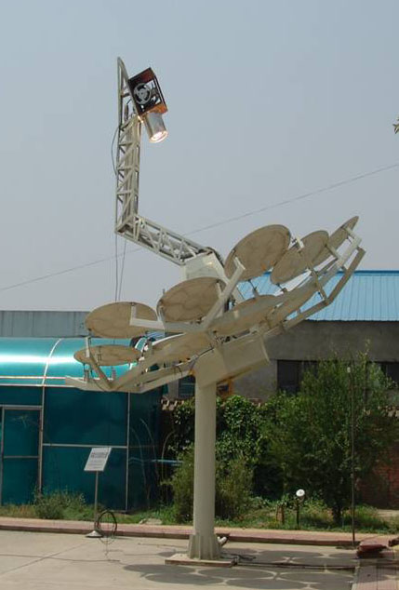
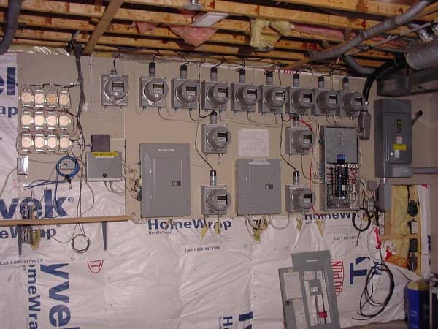
Cogeneration Stirling Engine with External “Combustor”
Gaseous, Liquid or Solid Fuel or Solar– AC or DC “backbone”
Generates heat and electricity
Optimize BOP
Alternative renewable energy sources

Slide 42
Potential Issue with Micro-Cogeneration Systems
For many system, to always operate at peak efficiency, there must either be means to significantly modulate some of the outputs in relation to others, or to find other applications or sinks for those excess outputs, either on a short or long term basis
There may be a need for electricity, but not for so much heat, or vice-versa.
In a similar vein . . .

Slide 43
Intermittent Renewable Energy

Slide 44
Intermittant Renewable Energy
Renewable energy sources, particularly wind and solar, are not always there when we need the energy, but can be there (in significant quantities) when we do not require the energy.

Slide 45
To ensure optimal utilization and performance, some form of energy storage may be the best solution

Slide 46
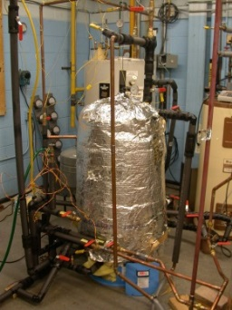
Energy Storage
Heat Storage Short-term
Liquid (water)
High thermal mass solids
Phase-change

Slide 47
Energy Storage
Heat Storage – Medium/Long Term
Boreholes
Residential (solar or microcogen)
Industrial waste heat
Community (solar)

Slide 48
Micro-Cogeneration with Borehole Heat Storage & Water Source Heat Pump

Slide 49
Energy Storage - Electricity
Lithium-Ion Batteries
Super Capacitors
PHEV
Pumped Storage
Renewably-derived Hydrogen
Charging at low demand and putting electricity back into dwelling at time of peak demand

Slide 50
Solar Energy Heating

Slide 51
Solar Hot Water

Slide 52
Solar Heated Community
with Seasonal Borehole Storage
Heat delivery based on eKocomfort technology, considering low exergy heat with high comfort

Slide 53
Solar Heating Drake Landing Alberta (9500 DD)
Drake Landing, 52 home subdivision near Calgary has achieved of 97% solar fraction, and has been awarded the World Sustainable Energy Trophy
With our builder & utility partners, we are now looking at 400 and 1000 home installations in the Yukon and at Fort McMurray ( really NORTH!!)
Notes:
[Allow for 2 minutes of speaking]
On this slide, highlight a significant 2009 project accomplishment with staff. Here are suggestions for the type of content you could discuss with this slide [NOTE: not everything that you will say needs to be typed on the slide]:
What is so significant about this project?
Who is being impacted by this project and How are they being impacted?
Why is this project relevant: To Canadians? To CanmetENERGY? To NRCan?
Who were they key CanmetENERGY contributors to this significant achievement?

Slide 54
Hybrid Integrated Appliance
Space Heating, Water Heating, Ventilation Driven by Solar Energy & High-Modulation Gas-Fired Condensing System (possibly PV-driven)

Slide 55
What’s next ??

Slide 56
PVT Photovoltaics + Thermal

Slide 57
New Renewable Fuels
Renewably-derived Hydrogen blending with natural gas, across the gas network
Bio-fuels and bio-diesel (liquids)
Alcohols and blends
Alternative solid fuels (corn, straw, composite …)
WASTE HEAT

Slide 58
Smart Energy Networks Homes & Communities: Heat, Electricity, Fuel
Wind

Slide 59
Smart Energy Networks
Wind

Slide 60
Summary
Integrated, Hybrid Technologies offering high modulation in output, offer superior means to utilize renewable energy resources and to move to low to net zero energy homes, buildings and communities.
High efficiency woodstoves, coupled with high performing minisplits look like an interesting, efficient, pleasant and comfortable pathway towards net zero for many homes
Energy storage for both heat and electricity offers the means to more effectively to utilize renewables and other energy forms much more effectively
With natural gas appearing to be available for a long time at low prices (despite the little blip at the moment), efforts should be made to integrate renewables with gas, to ensure a smooth long term transition to a renewable energy economy.
Smart Energy Networks, both at the local (house) and community level, are intelligent way to effectively use all our energy resources to their utmost, while minimizing GHGs and moving to overall net zero.

Slide 61
Review of Objectives (1)
Understand the distinction and opportunities with combined, integrated and hybrid energy systems
Appreciate range of advanced hybrid energy systems that can effectively & efficiently provide heat, ventilation, and even electricity, while integrating renewables and low-to-zero C-emitting fuels
Understand the drawbacks of certain energy sources, technologies and directions

Slide 62
Review ofLearning Objectives (2)
Appreciate how energy storage and renewably-derived fuels can allow effective utilization of intermittent or seasonally-variable renewable energy (solar, wind), when coupled with hybrid technologies
Be better able to specify energy systems to move new and existing homes and building clusters toward net-zero

Slide 63
If further questions, contact me (Skip Hayden) Renewables & Integrated Energy Systems tel: (613) 829 9896 fax: (613) 992 9335 e-mail: skip.hayden@nrcan.gc.ca

Slide 64
Fuel Energy Contents
Heating Oil 140 kBtu/gal
Natural Gas 1 007 Btu/ft³ 100000 Btu/therm
Propane 92.7 kBtu/gal
Electricity 3413 Btu/kwh
Mixed Hardwood 22 Mbtu/fullcord
Wood Pellets 336 kBtu/bag or
16.8 MBtu / ton

Slide 65
Hydrogen Losses for Different Fuels
Heat Loss, %

Slide 66
Dewpoints for Different Fuels
ºF
Excess Air, %

Slide 67
Gas in a house moving to Net Zero

Slide 68
Condensing boilers with high modulation ideally suited to fan coils, radiant floors and low energy housing

Slide 69
Can a condensing boiler condense in lowered energy housing?
Yes, if radiant floor
Likely, if fan coil to warm air
Possible in conventional hydronic, by integrating outdoor reset; reducing flowrate; now oversized heat exchange, service water preheat, preheat ventilation air, as with . . .

Slide 70
With housing moving towards net zero
Space heat demands are falling
Domestic hot water an increasing fraction
With tight envelope, need for ventilation air

Slide 71
Photovoltaics + Thermal (PVT)

Slide 73
10 top questions to ask about micro cogeneration….
What drives the conversion of natural gas to electricity ?
Thermodynamics and technology (10% for Stirling, 20 % + for ICE, and 30 % + for Fuel Cells)
What drives the recovery of heat ?
Return temperature of heat transfer fluid, radiant floors best
What drives the matching of the unit to building loads ?
Power to heat ratio, ability to modulate, part load efficiency, supplementary firing capability
What is meant by “embedded” micro cogeneration ?
Electricity generated on customer’s side of meter, works best with “Net Metering”
What changes when a “Feed-In-Tariff” is being considered ?
Electricity generated independently of end user, and fed to grid using a dedicated meter
What is the best value proposition for micro cogeneration ?
Lease unit from gas utility, who collect emissions credits and electricity demand reductions
Offset coal based electricity, thereby reducing attributable emissions (Saskatchewan and Ontario)
Unload electricity distribution system to minimise transmission losses
Evaluate micro cogeneration against a reference case satisfying the same electrical AND thermal load
Can a micro cogeneration system be used when the grid is unavailable (i.e. during an outage) ?
At present no, most systems are designed to sell electricity, and need the grid to start
Who are the major players worldwide ?
< 10 kWe: Whispergen, Honda/Climate Energy, AISIN (Toyota), YANMAR, Marathon, Senertec-DACHS
> 10 kWe: YANMAR, Cummins, G-Box 50 by European Power Systems (Ontario)
Has a dominant architecture emerged ?
Likely to be asynchronous permanent magnet alternator + rectifier + inverter, where locally certified inverter carries disconnect and islanding protection, some circuit management and electrical storage may also prove worthwhile, technology to convert heat to cooling in summer would be a game changer
Is there a Canadian product coming to market ?
Yes, a 6 kW on-grid / off-grid capable prototype with condensing heat recovery is being tested now

Slide 74
A mix of heating types ?

Slide 75
Electric Baseboard
Does this really happen?
Heat goes up against point of major heat loss
Stays on house periphery or ceiling
Needs some forced circulation
High cost of electricity

Slide 76
Characteristics of Efficient, Safe Gas Fireplace or “Stove”
Direct vent (sealed combustion)
Ceramic viewing glass front
Good input/output modulation
IID or easily shut-off / relit pilot
Effective circulating fan with DC motor
Free-standing or iInsulated outer casing
High P.4 seasonal efficiency
Properly sized & well-located in major living area

Slide 77
Heat Pumps

