Slide 1
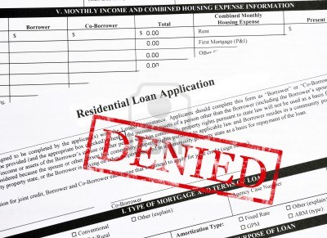
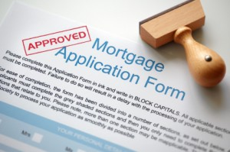

No Loan – No Project
Strategies for Working with Appraisers, Lenders, & Realtors
Jeffrey Gephart, Vermont Green Home Alliance
Better Buildings by Design 2014
February 6, 2014 - Burlington, VT

Slide 2
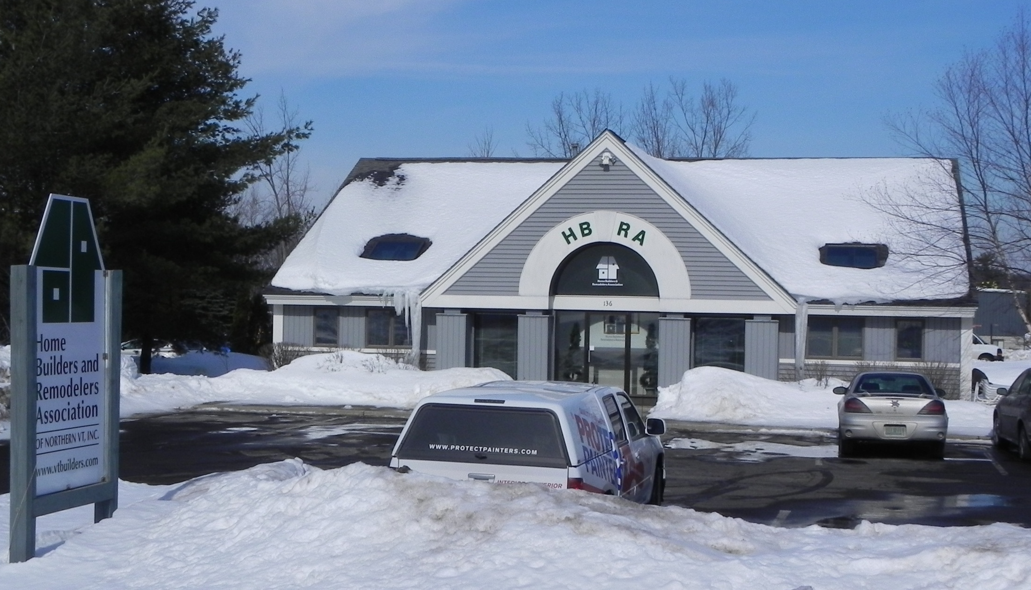
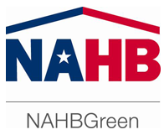
The Home Builders & Remodelers Association of Northern Vermont (HBRANV)
In early 2008, the HBRANV sought advice about rolling out the NAHB’s National Green Building Standard™ in Vermont.

Slide 3


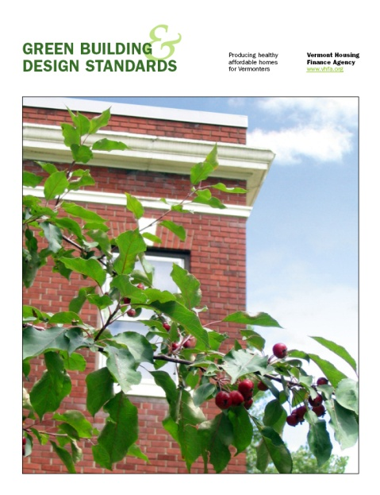
Vermont already had two green building certification programs…
& green building & design standards - requirements for financing through the Vermont Housing Finance Agency.

Slide 4
My Advice to the Home Builders Association…
Invite everybody involved in residential new construction energy-efficiency & 3rd party verified green building programs to a meeting.
There, explore if & how we might all work together to increase sustainable, “Green” home building in Vermont.

Slide 5

Outcome?
Rather than fighting for green building program market share.

Slide 6

Outcome!
We decided to work together.

Slide 7
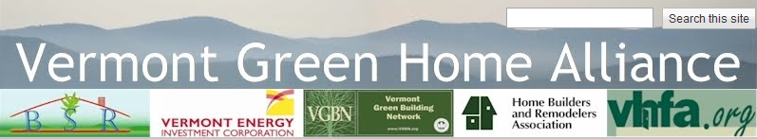
We came together & formed…
www.vermontgreenhomealliance.org

Slide 8

The Visibility Problem
Many aspects of what makes a home high performance are invisible.
The real estate market is ill-equipped to assess & value highly energy-efficient homes.
Without a loan & a supporting appraisal, including the additional capital to build it, many high performance projects will die on the vine.

Slide 9
To Address this Problem the Alliance Grew
Appraisers
  Appraisal Institute - Vermont Chapter
Lenders
  Vermont Mortgage Bankers Association
  Vermont Bankers Association
  Association of Vermont Credit Unions
  Vermont State Employees Credit Union
Realtors
  Vermont Association of REALTORS®
Home Inspectors
  Vermont Association of Professional Home Inspectors
The Vermont Passive House Alliance & the Energy Futures Group have also joined this effort.

Slide 10

Our Goal
Transformation of the real estate market so that sellers & buyers can identify & accurately value energy-efficiency benefits.

Slide 11

Real Estate Is Local (The MLS)
The Multiple Listing Service (MLS) is the real estate database.
The MLS displays homes for sale & sold.
Users can search for home features, such as square footage, # of bathrooms/bedrooms, & in a few locations, energy performance data.
Primary tool used by appraisers to find “comparable” value homes from actual sales data.
Of the ~850 independent MLS across the country, only ~150 MLS have “Green Features.”
Our MLS is the Northern New England Real Estate Network (NNEREN).

Slide 12
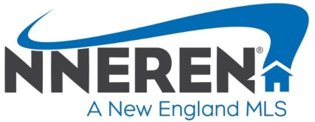

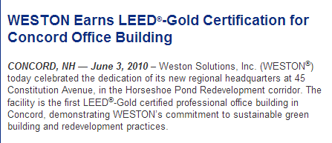
Our MLS covers all of Vermont & New Hampshire, some of Maine & a tiny bit of Massachusetts.

Slide 13
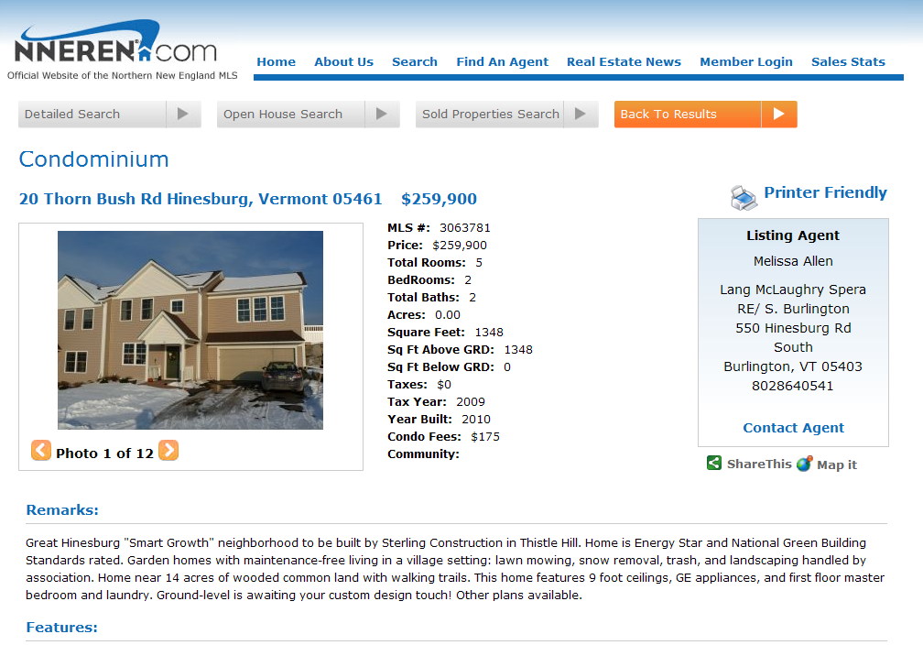
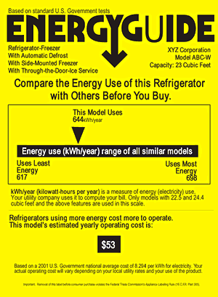
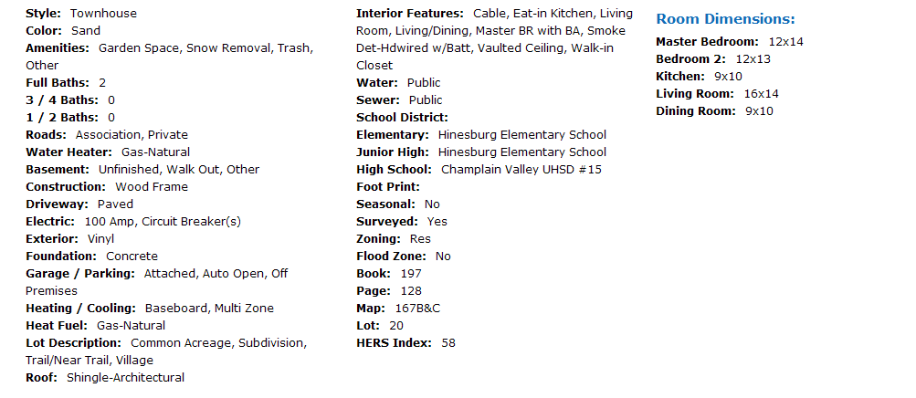
Public View (non-subscriber)
A graphic display of the HERS Index score in the MLS will function more like the EnergyGuide label & provide context.

Slide 14
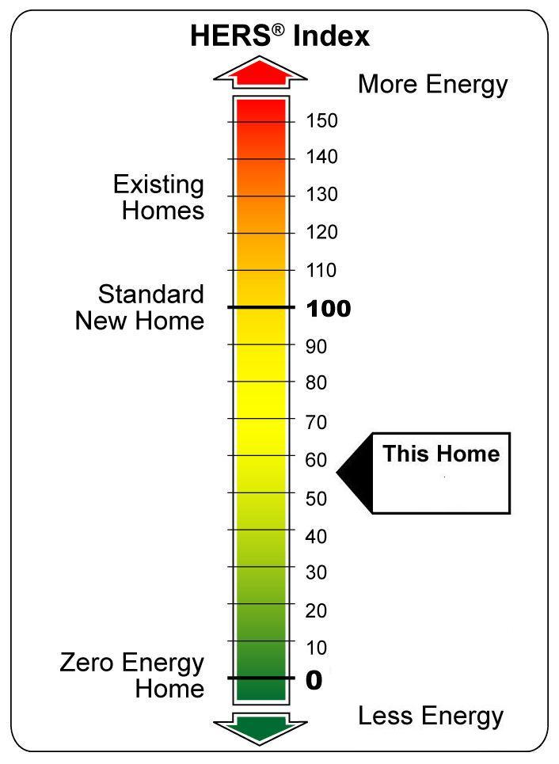
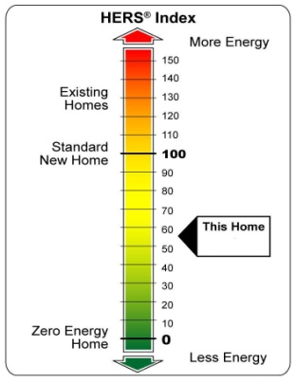
Public View (non-subscriber)
A graphic display of the HERS Index score is being developed by NNEREN & provide context for HERS scores in the future.
58
58

Slide 15
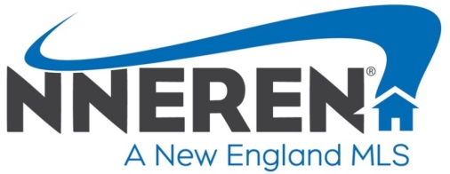
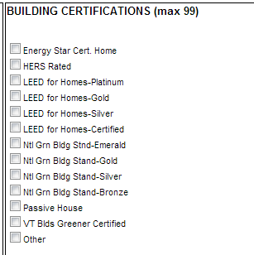
Third-party verified building certifications added to NNEREN MLS
(subscriber input fields)

Slide 16
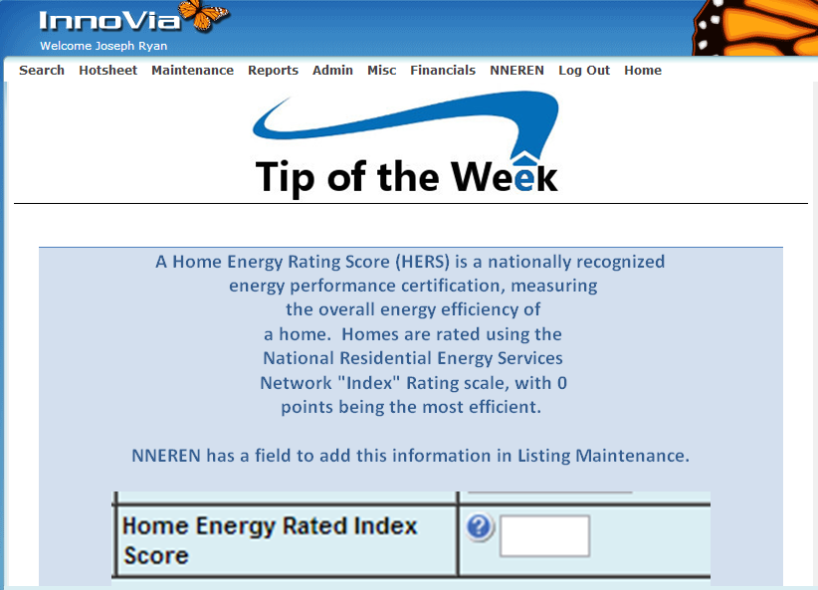

Subscriber View
Provide your MLS & subscribers with educational support.

Slide 17

Greening Our MLS
Northern New England Real Estate Network
Using Home Energy Ratings & Building Certifications to Document & Market Energy-Efficient & Green Certified Homes at NNEREN.COM
Webinar by
Jeffrey Gephart
Trade Ally Outreach Contractor
Efficiency Vermont/Vermont Energy Investment Corp.
800-893-1997
vtwise@together.net
Subscriber View

Slide 18
Efficiency Vermont Supplements MLS Data
Many of the most energy-efficient and green-certified homes being built are custom homes that are rarely listed on the MLS.
To help appraisers & realtors to better understand the market & to better identify comparable home sales,
Efficiency Vermont created a database appended to the MLS that lists all homes that get HERS Ratings & earn 3rd party verified building certifications.

Slide 19

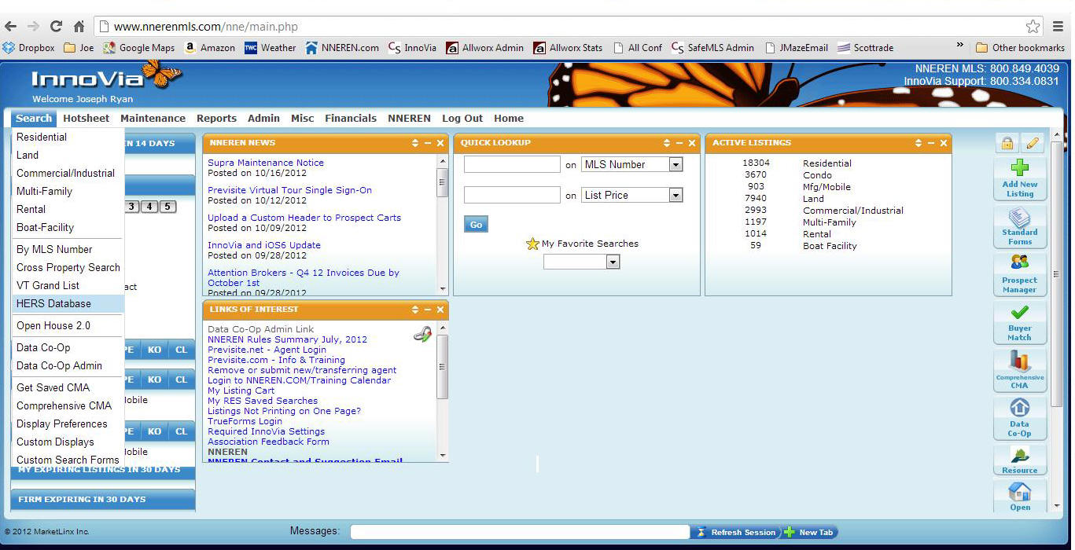
Home Energy Rating & Building Certification
Appraiser Database
This MLS subscriber view shows the VT Grand List (listing home values per town property tax assessors).

Slide 20

Home Energy Rating & Building Certification Appraiser Database

Slide 21
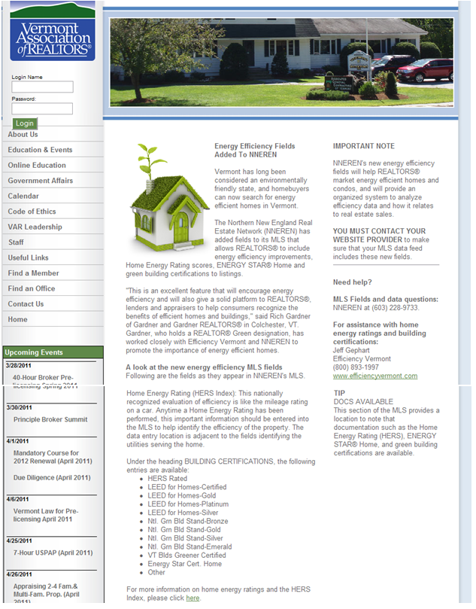

Vermont Association of REALTORS® website:
Notice that HERS scores & building certifications can now be entered into the MLS…
& that brokers with their own MLS portals should be sure to pick up the HERS score & building certifications for display on their website.

Slide 22
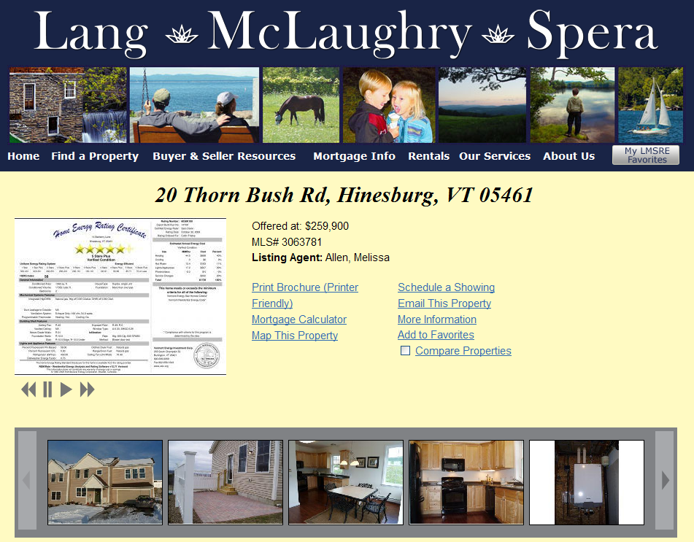
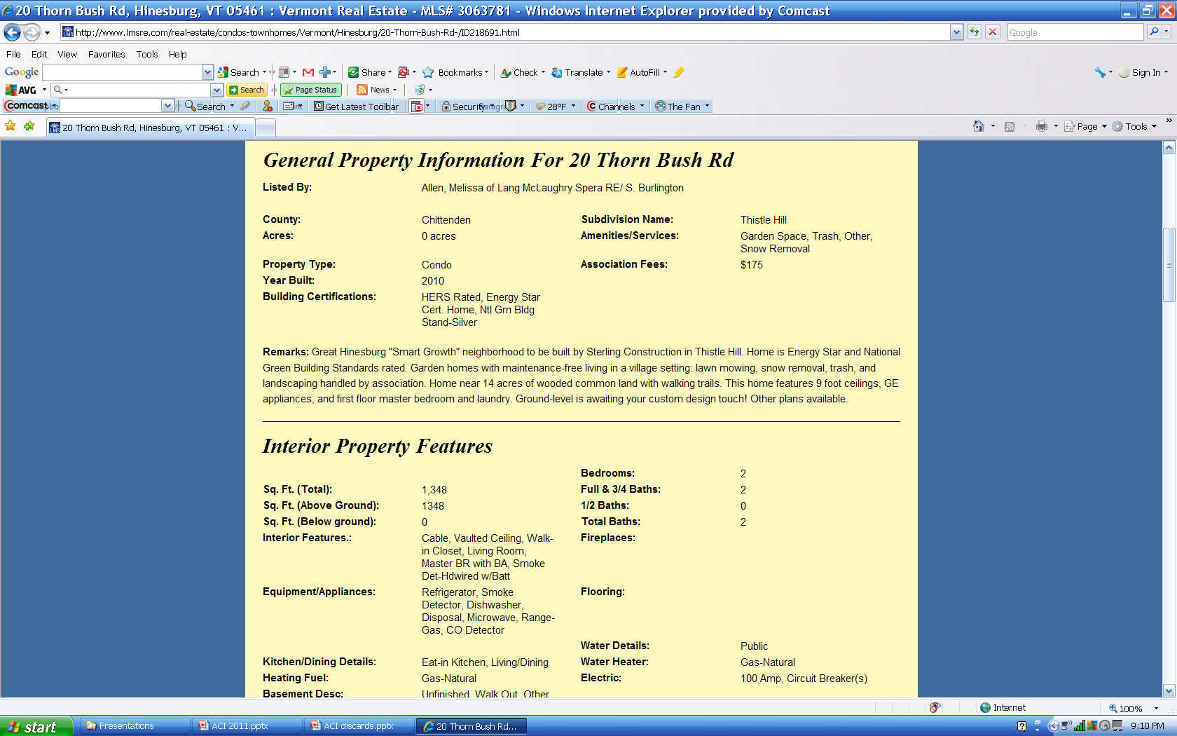
A VT real estate firm’s website displaying building certifications from the NNEREN.com website
Nice document display feature on MLS website too

Slide 23
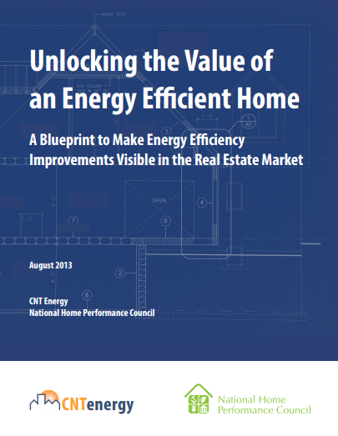
Nation Efforts
To become familiar with supporting national efforts.
Recommended reading:
Explains national efforts to coordinate communications between the building & energy-efficiency communities & the real estate, lending, & appraisal industries utilizing the “Greened” MLS as a common data repository.
www.elevateenergy.org/wp-content/uploads/2014/01/Unlocking_the_Value_an_Energy_Efficient_Home.pdf

Slide 24

“Through a 5-year Memorandum of Understanding with the US Department of Energy, The Appraisal Foundation is very much incorporating the valuation of green buildings in the work of our three independent Boards”:
  Appraisal Practices Board (APB),
  Appraisal Standards Board (ASB), &
  Appraiser Qualifications Board (AQB).
  John S. Brenan, Director of Appraisal Issues, The Appraisal Foundation

Slide 25
“The Appraisal Practices Board (APB) has begun the process of providing guidance on recognized valuation methods and techniques of green buildings with the creation of its first Subject Matter Expert (SME) panel on the topic, Background Competence.”
The APB intends to create two additional panels:
  Valuation of Residential Green Buildings, and
  Valuation of Non-Residential Green Buildings.
  John S. Brenan, Director of Appraisal Issues, The Appraisal Foundation

Slide 26
“The Appraiser Qualifications Board (AQB) adopted revisions to the Real Property Appraiser Qualification Criteria that will become effective on January 1, 2015,”
“which will require individuals wishing to obtain an appraiser's license or certification to complete qualifying education in the valuation of green buildings,”
“and for those who already possess an appraiser credential, continuing education related to the same topic.”
John S. Brenan, Director of Appraisal Issues, The Appraisal Foundation

Slide 27
“Lastly, the Appraisal Standards Board (ASB) will issue guidance related to complying with the Uniform Standards of Professional Appraisal Practice (USPAP) when valuing green buildings.”
John S. Brenan, Director of Appraisal Issues, The Appraisal Foundation

Slide 28
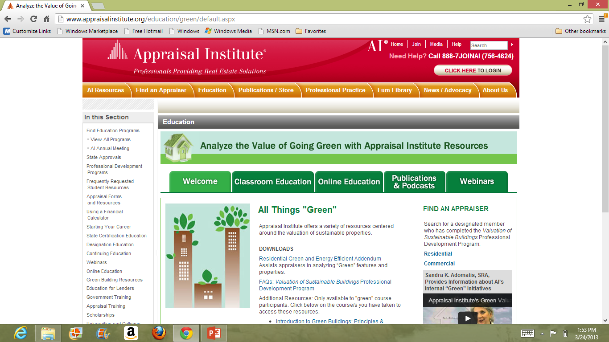
The Appraisal Institute (AI) is a membership organization whose “mission is to advance professionalism and ethics, global standards, methodologies, and practices through the professional development of property economics worldwide.”
The Appraisal Institute has acknowledged that appraisers need more education about energy efficiency & green building.

Slide 30
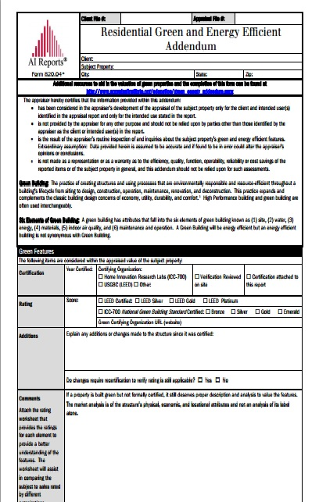
Residential Green & Energy Efficient Addendum
“The objective of this Addendum is to standardize the communication of the high performing features of residential properties.”
“Identifying the features not found on the 1004 form provides a basis for comparable selection & analysis of the features.”
“Builders, contractors, homeowners, and third party verifiers are encouraged to complete this Addendum and present to appraisers, agents, lenders, & homeowners.”
www.appraisalinstitute.org

Slide 31

From: Steve Baden
Sent: Friday, October 25, 2013 4:28 PM
Subject: RE: HERS & the Residential Green & Energy Efficient Addendum
We just received the formal approval from the Appraisal Institute to have the energy addendum produced by accredited RESNET rating software programs. I will now begin working with the accredited HERS software program to incorporate the report in their rating programs. Goal is to have changes incorporated in time for the next release of their new versions.
RESNET is in the beginning steps in discussion of being able to disseminate energy performance on rated homes directly into MLS organizations via a schema. There are many details (privacy, technical, financial, etc) that have to be resolved first. I, however, am confident that they can be worked out.

Slide 32
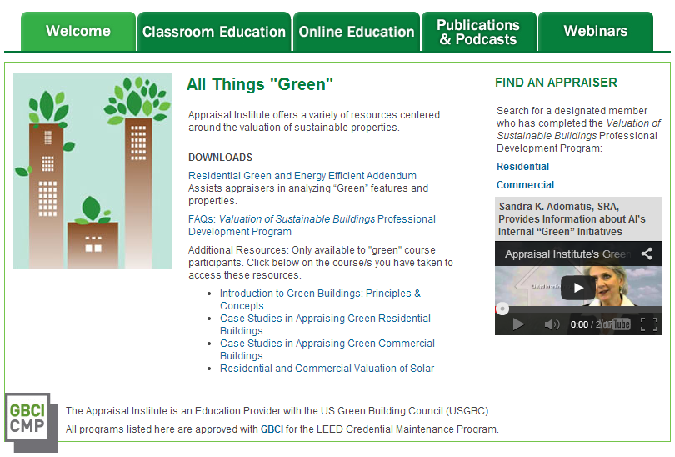
Valuation of Sustainable Buildings Professional Development Program & Registry
  While AI should be praised for their pioneering efforts,
  unfortunately, knowledge & use of these valuation tools by appraisers & lenders is rare.

Slide 33
Valuation of Sustainable Buildings Professional Development Program & Registry
  While AI should be praised for their pioneering efforts,
  unfortunately, knowledge & use of these valuation tools by appraisers & lenders is rare.

Slide 34


Why Are There Issues With Appraisals?
Appraisers must have credible market evidence that energy-efficiency is valued
but, as their work helps establish market value & they have historically not been trained to recognize efficiency & have lacked the tools & data to assign value for energy-efficiency, we encounter a classic conundrum.
Which comes first?

Slide 35
Educate Yourself About Appraisal Methods
Sales Comparison Approach (or Market Approach)
  Most common & required by Fannie Mae and Freddie Mac
Cost Approach
  Less common but likely most appropriate as secondary evidence for highly-energy efficient homes where comparable homes don’t exist.
Income Capitalization Approach
  Currently used with rental properties.

Slide 36
Sales Comparison Approach or Market Approach
A method of appraising property by analyzing the prices of similar properties sold in the recent past and then making adjustments based on differences among the properties and the relative age of the other sale. More properly called the direct sales approach.
The Complete Real Estate Encyclopedia by Denise L. Evans, JD & O. William Evans, JD. Copyright © 2007 by The McGraw-Hill Companies, Inc.
Residential appraisers rely heavily upon the sales comparison approach to establish the value of a home even when there are statistically insignificant numbers of green or energy-efficient home sales to compare to.
(or where the perception exists that there are few comparables)

Slide 37
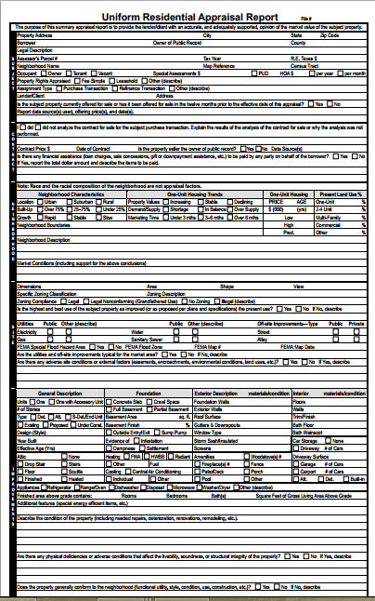
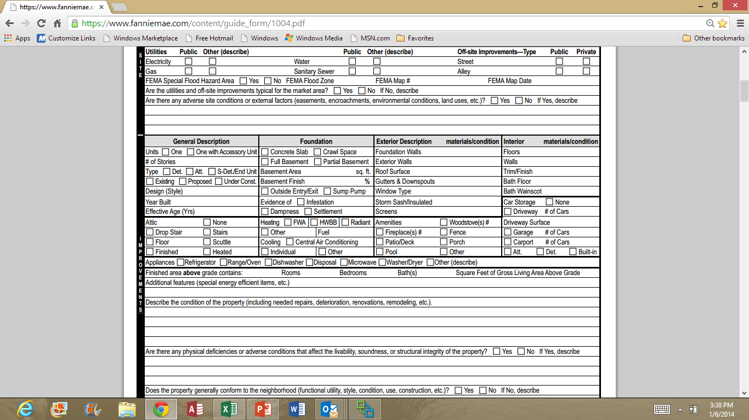
Uniform Residential Appraisal Report-URAR
Fannie Mae Form 1004/Freddie Mac Form 70 include a data field (a single line) for “Energy Efficient Items” within the Uniform Residential Appraisal Report.

Slide 38
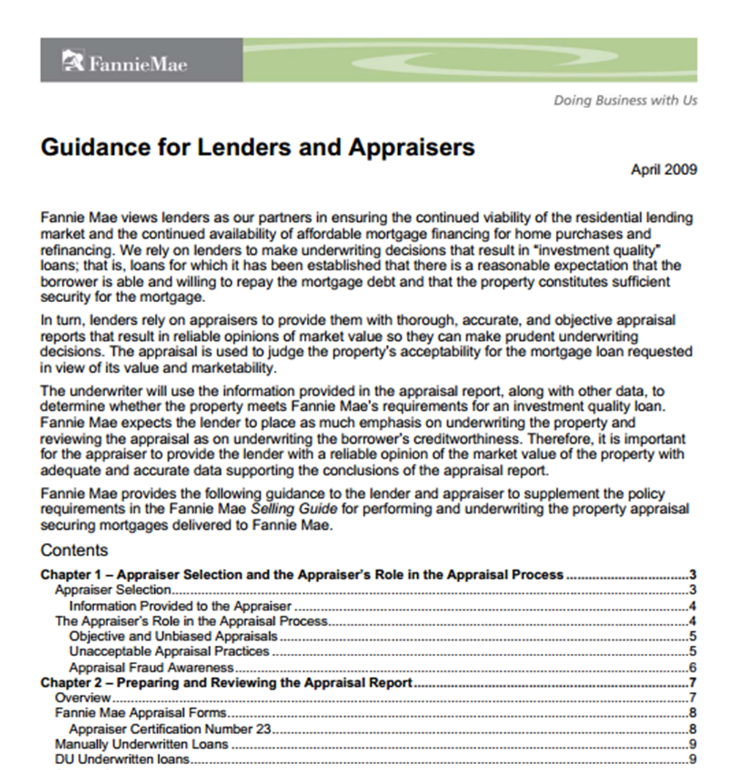
Uniform Residential Appraisal Report-URAR
Fannie Mae Form 1004/Freddie Mac Form 70 include a data field (a single line) for “Energy Efficient Items” within the Uniform Residential Appraisal Report.
Recommended reading: Fannie Mae’s Guidance for Lenders and Appraisers (2009©) on how it is to be completed.

Slide 39
Cost Approach
With green & energy efficient building now being recognized as a new market influencer, appraisers can now justify using cost data as secondary evidence to support adjustments identified under the sales comparison approach.
Cautionary Note: In valuation COST does not necessarily equal VALUE.
Best to get “Reproduction” cost from builders in the local market (like you)
  Reproduction Cost: “the estimated cost to construct, at current prices as of the effective date of the appraisal, an exact duplicate or replica of the building being appraised, using the same materials, construction standards, design, layout, and quality of workmanship and embodying all the deficiencies, superadequacies, and obsolescence of the subject building.” Dictionary of Real Estate Appraisal, fifth edition

Slide 40
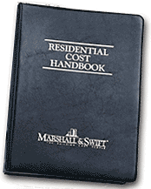
Cost Approach
Appraisers can also use the Residential Cost Handbook from Marshall and Swift, an internationally renowned source of cost-to-build data.
This Handbook now provides green building cost information.

Slide 41
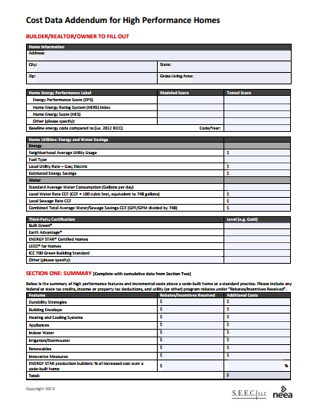
Cost Approach
The Pacific Northwest region has been working on real estate market transformation for some time.
The Cost Data Addendum for High Performance Homes V2 was developed by the Northwest Energy Efficiency Alliance (NEEA) & Social, Environmental & Economic Consulting, LLC (SEEC LLC).
This form is a good tool for providing cost data for appraisers to use & can be downloaded at no charge.
http://seecsolutions.com/wp-content/uploads/2013/03/EHI_Cost-Data-Addendum_03-04-13.pdf

Slide 42
Income Capitalization Approach
Definition:
A real estate appraisal method that allows investors to estimate the value of the property based on the income produced. The income approach is computed by taking the net operating income of the rent collected and dividing it by the capitalization rate (the investor's rate of return). Source: www.investopedia.com/terms/i/income-approach.asp
This approach is currently considered appropriate for income producing properties such as apartments, rental homes, and businesses.

Slide 43
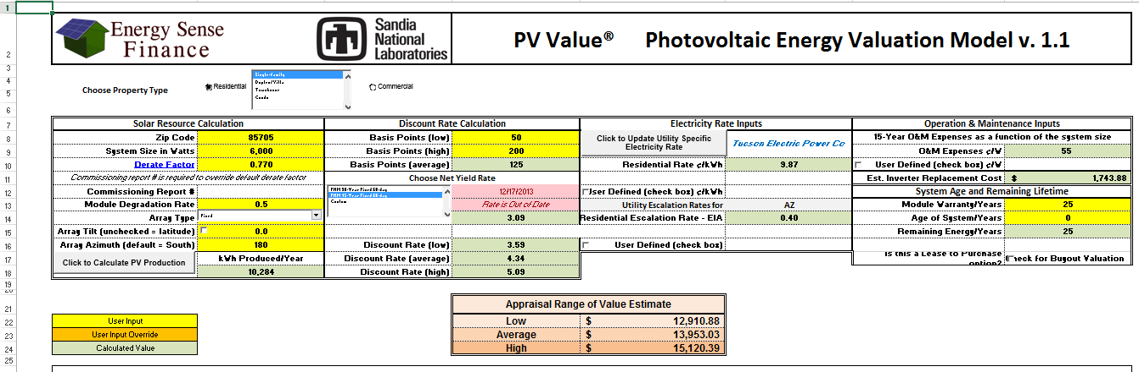
Income Capitalization Approach
PV Value®
This spreadsheet is intended to help determine the value of a new or existing photovoltaic (PV) system installed on residential and commercial properties.
For use by real estate appraisers, mortgage underwriters, credit analysts, real property assessors, insurance claims adjusters, & PV industry sales staff.
http://energy.sandia.gov/?page_id=8047

Slide 44
Income Capitalization Approach
In An Introduction to Green Homes by Alan F. Simmons, SRPA, LEED AP, ©2010 by the Appraisal Institute, the author states:
The benefits of a green building are probably most directly measurable through the income capitalization approach. As compared to a conventional building, a sustainable building may have
  Higher rents
  Lower vacancies
  Lower operating expenses
  Less risk
All these factors should result in a higher net income and value.

Slide 45
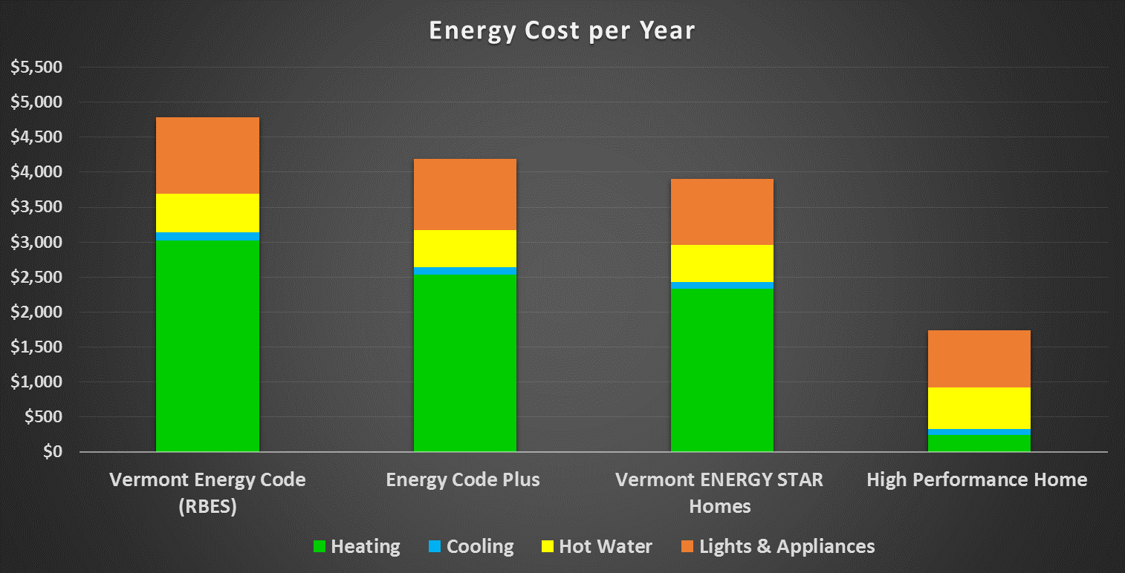
$4,783
$4,190
12% less than code
$3,904
18% less than code
$593 savings
$879 savings
$1,739
64% less than code
$3,044 savings

Slide 46
Increased Cost
Savings
Savings

Slide 47


Income Capitalization Approach
For some reason the appraisal industry doesn’t recognize that an energy-efficient home that creates a positive monthly cash flow is generating a revenue stream?
“The benefits of a green building are probably most directly measurable through the income capitalization approach.” An Introduction to Green Homes by Alan F. Simmons, SRPA, LEED AP

Slide 48

Mandating the Income Capitalization Approach?
Sensible Accounting to Value Act of 2013 (SAVE Act):

Slide 49
Mandating the Income Capitalization Approach?
Sensible Accounting to Value Act of 2013 (SAVE Act):
For homes with HERS ratings, the loan underwriter would be required to add the projected energy savings to the homeowner’s income when conducting a debt-to-income analysis.
The lender or appraiser would also be required to add the present value of the energy savings (over the life of the loan) to the value of the home when conducting a loan-to-value analysis.
  For instance, the present value of 30 years’ worth of $2,000 annual energy savings (at 4% discount rate) is about $35,000.
  That is to say, the appraiser/lender would need to add $35,000 to the value of the house to account for the energy savings.
  A home that would otherwise be appraised at $350,000 would now be valued at $385,000 for this analysis.
Analysis by John Semmelhack, Think Little

Slide 50
Income Capitalization Approach
To support the use of the Income Capitalization Approach we hope that in the future Efficiency Vermont will be able to calculate the net present value (NPV) of the energy savings for a HERS Rated home versus a home built to our minimum state energy code (RBES) specifications.
You may be able to make such a calculation yourself &, if so:
  Include the NPV on the AI Addendum provided to the appraiser & lender.
  These savings are especially significant with highly energy-efficient homes.

Slide 51
Communication Allowed under Lending Guidelines – Dodd-Frank Bill
Appraisers can talk with builders, brokers, agents, and sellers.
Builders, brokers, agents, and sellers can provide the appraiser with documents.
Builders, brokers, agents, and sellers can accompany appraiser on the inspection.
Appraisers cannot be pressured by loan officer or others involved in the process to arrive at a value conclusion or to omit important facts.
Source: High-Performance Appraisals: Steps for Success – August 7,2013
Sandra Adomatis

Slide 52
The Competency Rule Applies to Your Project
An appraiser must:
be competent to perform the assignment,
acquire the necessary competency to perform the assignment, or
decline or withdraw from the assignment.
Competency requires:
The ability to properly identify the problem to be addressed, and
The knowledge & experience to complete the assignment competently, and
Recognition of, and compliance with laws and regulations that apply to the appraiser or to the assignment…includes familiarity with a specific type of property.
Source: Appraising ENERGY STAR Qualified Homes - June 30,2010
Brian Ng, Karen Argeris, Donald Briggs, Sandra Adomatis

Slide 53
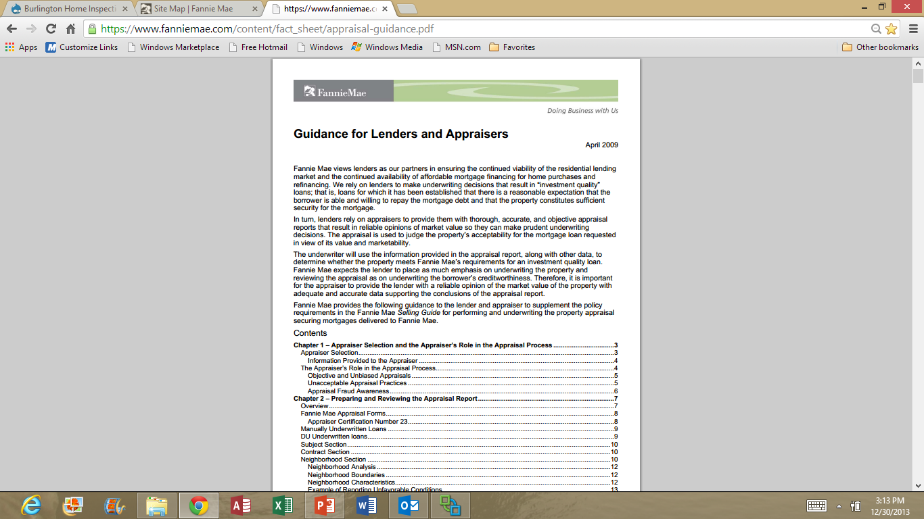
Fannie Mae
Guidance for Lenders and Appraisers
Dated April 2009 & still current

Slide 54
Fannie Mae Guidance for Lenders & Appraisers
In summary Fannie Mae requires that:
Lenders hire appraisers that have competency prior to accepting the assignment.
  This is a higher requirement than USPAP’s!
Lenders should establish appropriate appraiser qualification criteria and review procedures to ensure that the third party uses those qualification criteria in the selection process.
Some lenders are not adhering to these guidelines.
YOU have the RIGHT to expect a COMPETENT appraiser.
www.fanniemae.com/content/fact_sheet/appraisal-guidance.pdf

Slide 55
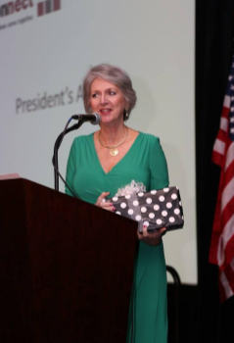
A Leading Appraiser’s Advice
Sandra Adomatis, the appraiser credited with developing the AI Addendum & ex-Vice Chair of the Appraisal Institute’s Education Committee, provides the following advice (augmented by the presenter):

Slide 56
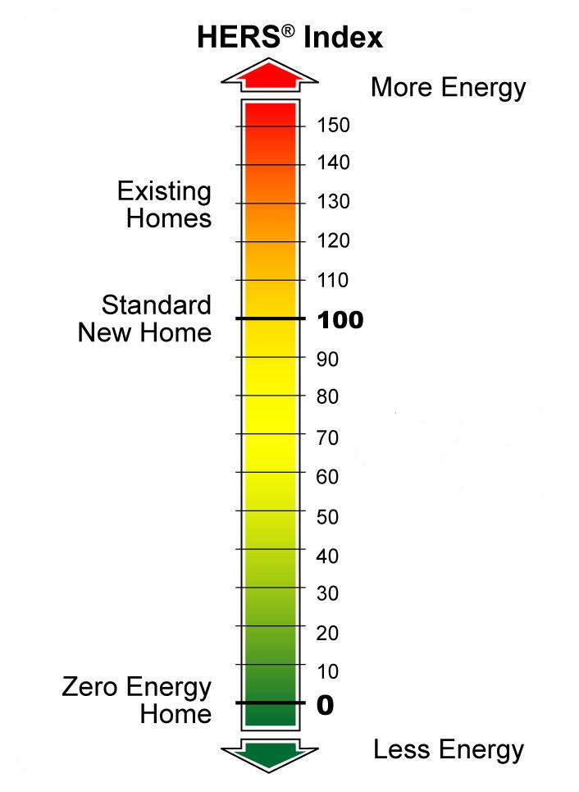
A Leading Appraiser’s Advice
Sandra Adomatis, the appraiser credited with developing the AI Addendum & ex-Vice Chair of the Appraisal Institute’s Education Committee, provides the following advice (augmented by the presenter):
Complete the AI’s Residential Green and Energy Efficient Addendum & attach a copy of:
  the state energy code compliance certificate (RBES)
  the full Home Energy Rating Report (including the Home Energy Rating Certificate)
  a graphic display of Home Energy Rating Index
  3rd party verified energy-efficiency or green building certifications
This Home
38

Slide 57
A Leading Appraiser’s Advice
Sandra Adomatis advises that you ask questions about the appraiser’s qualifications before the appraisal begins,
or your client could face the cost of two appraisals.
How many hours of energy-efficiency & green building education have they completed?
Adomatis feels that 14 hours is appropriate based on AI's “green” courses. Unfortunately, it is unlikely that many appraisers have that many hours yet, as these courses are so new.
What is their actual experience appraising green homes?

Slide 58
A Leading Appraiser’s Advice
More possible questions:
Is the appraiser familiar with the AI Addendum?
How will the appraiser assign value to the AI Addendum defined green categories: “(1) site, (2) water, (3) energy, (4) materials, (5) indoor air quality, & (6) maintenance and operation?”
Ask if the appraiser would calculate & use net present value of the annual energy cost savings, & if so, what are the assumptions, methodology & duration for their savings calculation?
Does the appraiser subscribe to the local MLS?
If no, this causes concerns about competency above & beyond green building!

Slide 59
A Leading Appraiser’s Advice
Provide the AI Addendum & attachments to the appraiser before beginning the site visit of the subject property.
Someone knowledgeable about the efficiency & green features in the home should accompany the appraiser to clarify, elaborate, & answer the appraiser’s questions.

Slide 60

When Selling a Home
Make sure your listing agent enters your home’s score in the HERS Index field & the building certification(s) earned in the MLS.
Let them know that they can find educational support materials at NNEREN.com.
Have your listing agent attach the AI’s Residential Green and Energy Efficient Addendum & other documents previously mentioned to the MLS listing.
Review with your Realtor & make sure they are able to explain to potential buyers that the cost of ownership will likely be less when the home is energy efficient & that they need to consider energy cost & mortgage costs together to understand the cost of ownership.

Slide 61
Increased Cost
Savings
Savings

Slide 62
Find a Supportive Mortgage Lender
The appraiser works for the bank, not the prospective buyer.
A supportive lender can help temper appraisal issues, & even offer helpful alternatives such as flexibility, on loan-to-value ratios.
Include the AI Addendum with the bank loan application…
(it’s the trigger with regard to the Competency Rule, PULL IT)!
Then work with the lender to find a competent appraiser.

Slide 63
Builder, Matt Belcher’s Agreement with Lenders:
This Home is being built/renovated/updated to nationally recognized standards above prevailing code.
It is designed and constructed with unique features and materials and with highly efficient equipment and in accordance with high efficiency standards.
The Lender shall choose an Appraiser educated and knowledgeable in this type of valuation of these specialized Homes, preferably an appraiser who holds a professional appraisal designation that requires advanced education on such issues as the valuation of sustainable buildings (e.g., MAI or SRA designations from the Appraisal Institute).
The appraiser shall provide verification of green valuation education of 14 hours or more from a qualified and knowledgeable educational provider and knowledge to be permitted to conduct the appraisal for this project.

Slide 64
It Is Up To Us
Some individuals will be motivated to build highly energy-efficient homes due to environmental ethics & global warming concerns.
More would be reached if our real estate market made visible the compelling, & quantifiable, economic benefits of building to very high performance levels.
We must convince lenders & appraisers that proper valuation of high performance buildings is a low risk, good business decision that also provides environmental benefits.
It is up to us – architects, builders, homeowners, efficiency program sponsors, trade groups - who seek to significantly & rapidly transform our built environment, to recognize the additional task we face in building a more rational real estate market & to work together to get this job done.

Slide 65
What Can You Do?
Complete the Appraisal Institute’s Residential Green and Energy Efficient Addendum for your new homes (or existing homes undergoing significant weatherization).
Provide the Residential Green and Energy Efficient Addendum for your clients’ use in financing their homes.
This is a critical step in making the invisible visible in our real estate market.
www.appraisalinstitute.org

Slide 66
Resources
Northern New England Real Estate Network (MLS)
www.nneren.com
Unlocking the Value of an Energy Efficient Home
www.elevateenergy.org/wp-content/uploads/2014/01/Unlocking_the_Value_an_Energy_Efficient_Home.pdf
Appraisal Institute’s Green Building Resources
www.appraisalinstitute.org/education/education-resources/green-building-resources/
Appraisal Institute’s Residential Green & Energy Efficient Addendum
www.appraisalinstitute.org/assets/1/7/ai-residential-green-energy-effecient-addendum.pdf
PV Value® (for use with residential or commercial PV systems)
http://energy.sandia.gov/?page_id=8047
Cost Data Addendum for High Performance Homes V2
http://seecsolutions.com/wp-content/uploads/2013/03/EHI_Cost-Data-Addendum_03-04-13.pdf
Fannie Mae Guidance for Lenders and Appraisers
www.fanniemae.com/content/fact_sheet/appraisal-guidance.pdf
* In green are specific forms for use with loan applications.

Slide 67

Thank You!
Questions?
Jeff Gephart – vtwise@together.net
For assistance see Efficiency Vermont’s Residential New Construction Services:
www.efficiencyvermont.com/for-our-partners/Residential-New-Construction-Partners/General-Info/Overview

